Slide 1


Internet clock
Name student

Slide 2
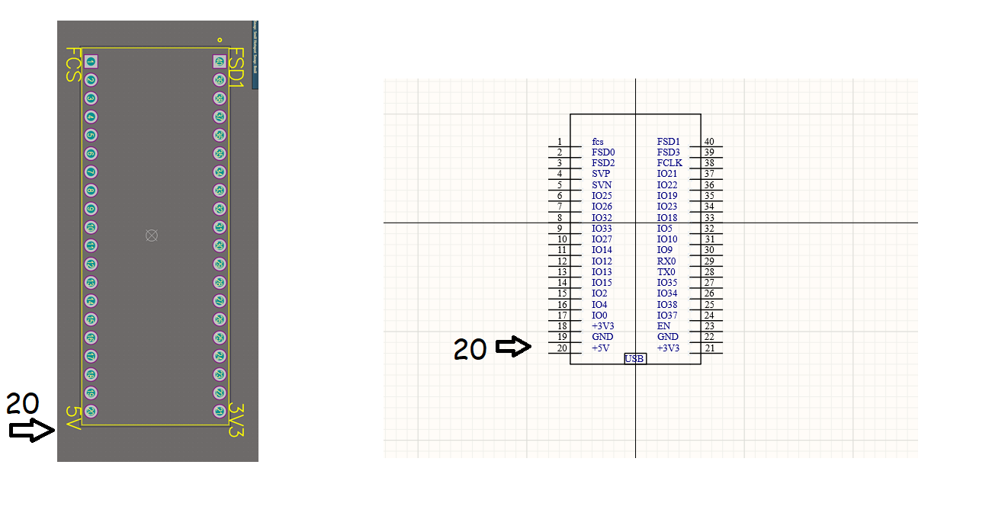
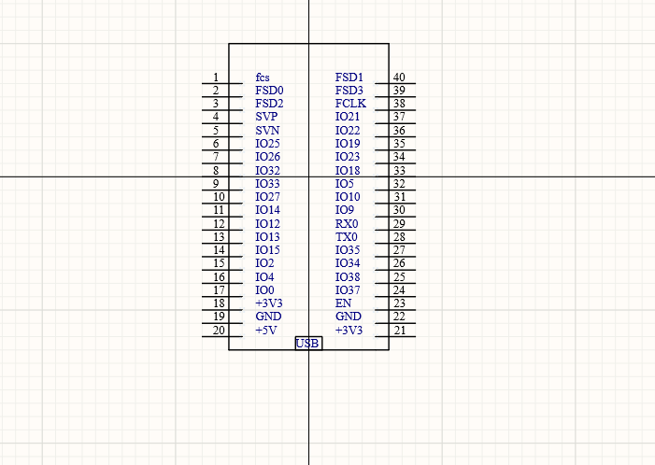
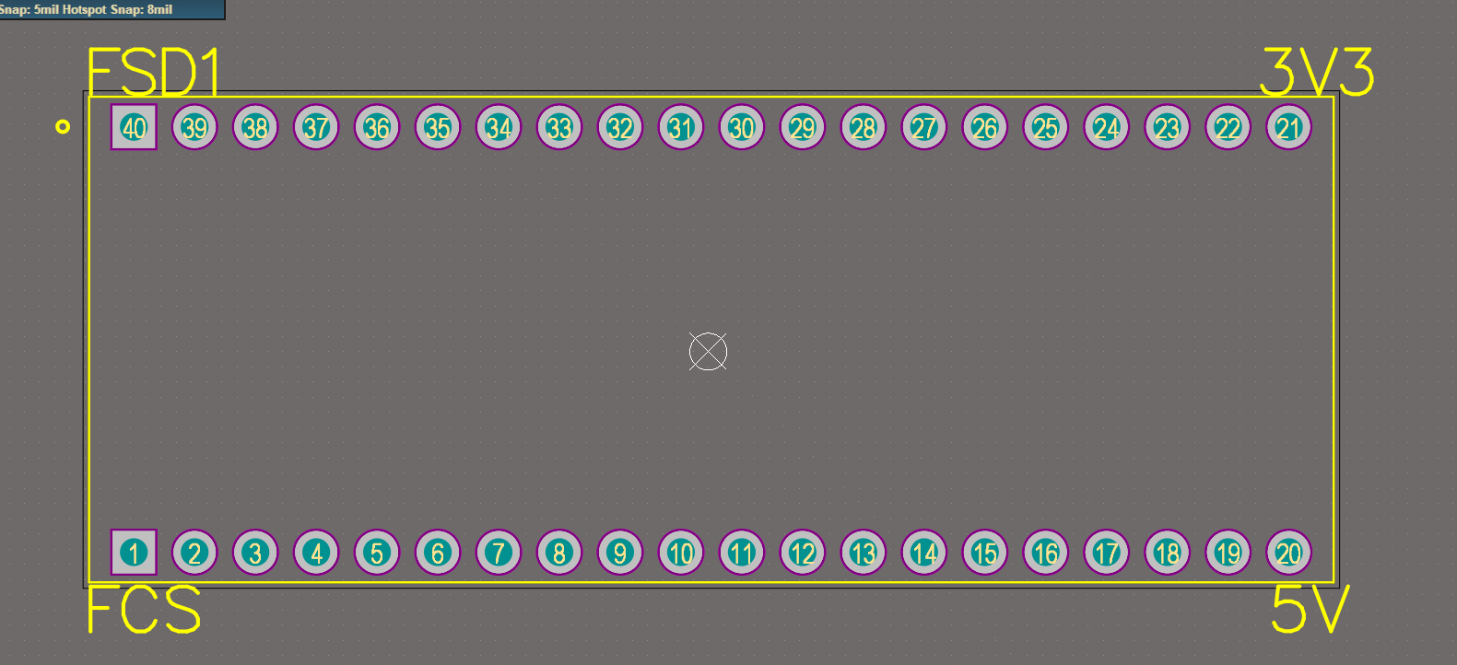

Personal component
Must match

Slide 3
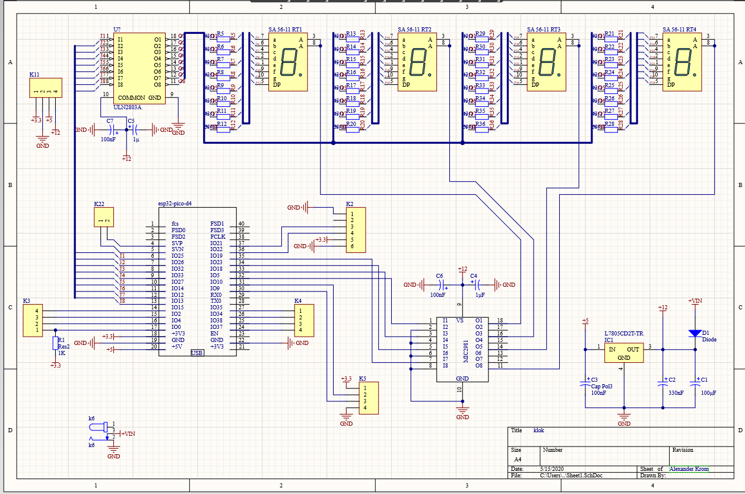
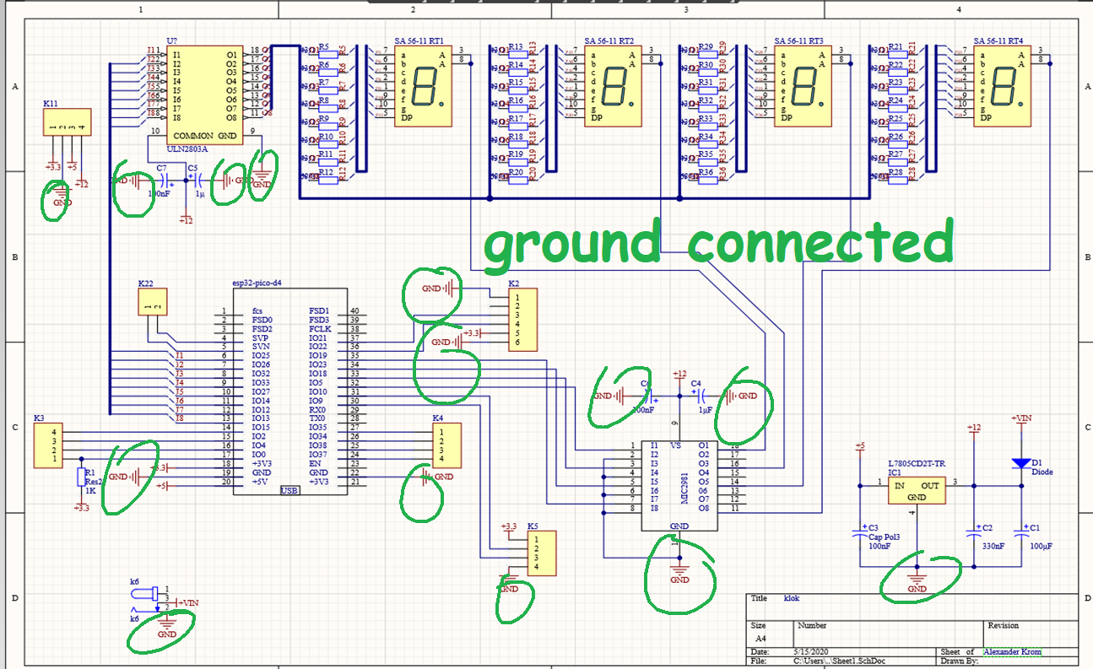
Component
Library
net name

Slide 4
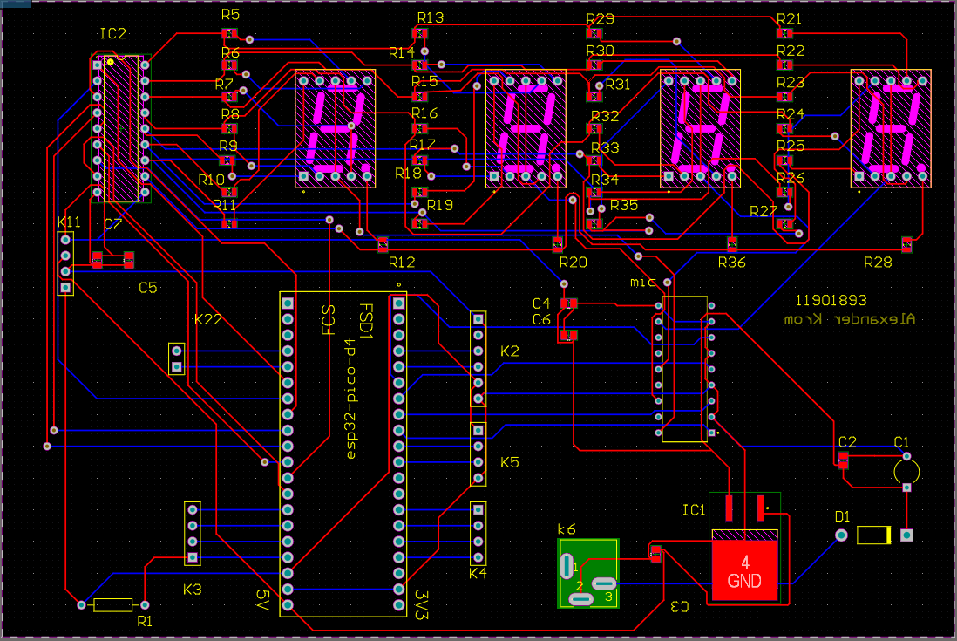
Pcb design
Mirror name
Auto root
Error fix/ straight lining

Slide 5
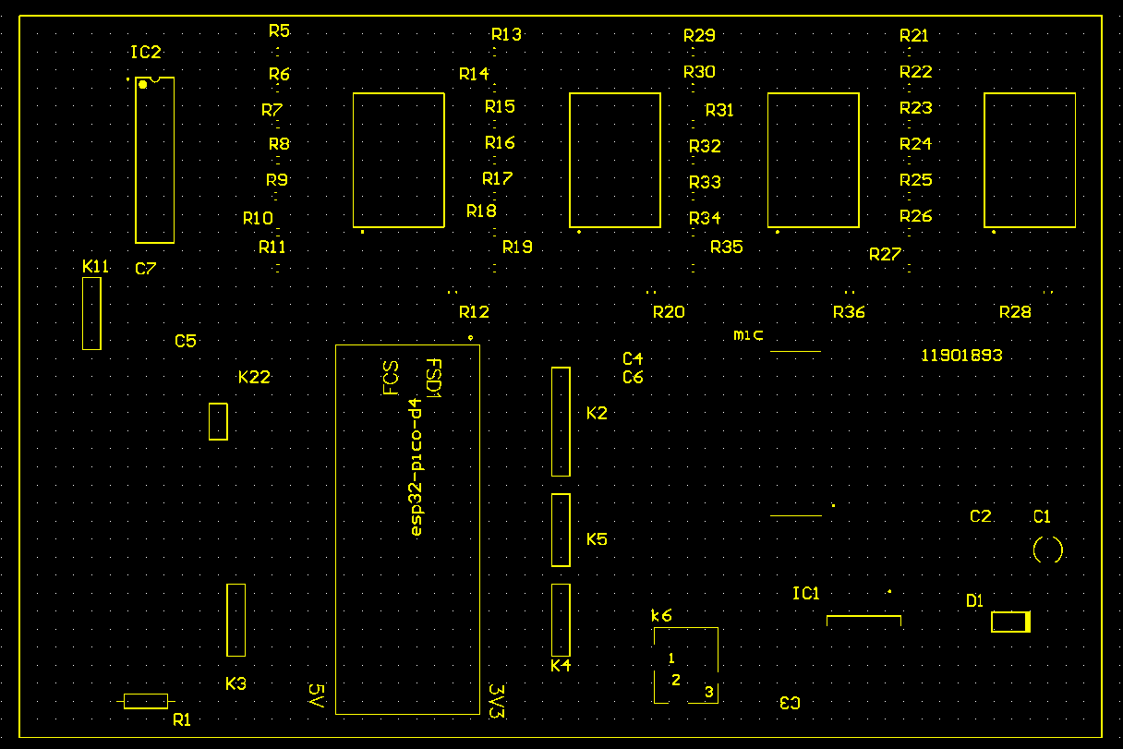
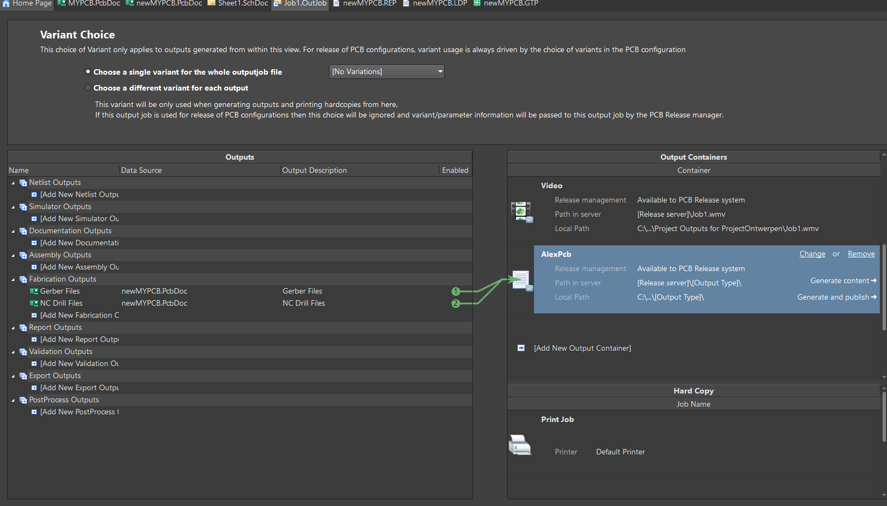
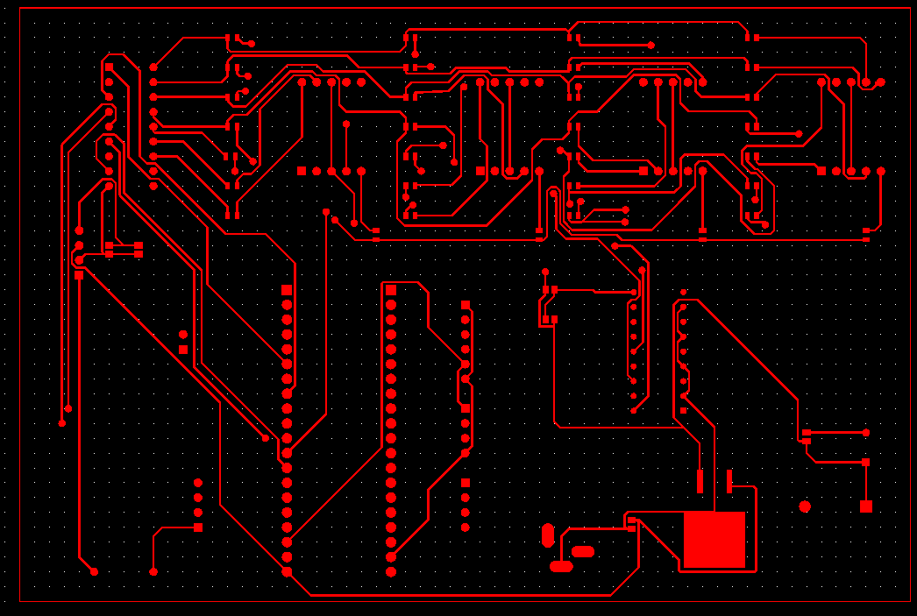
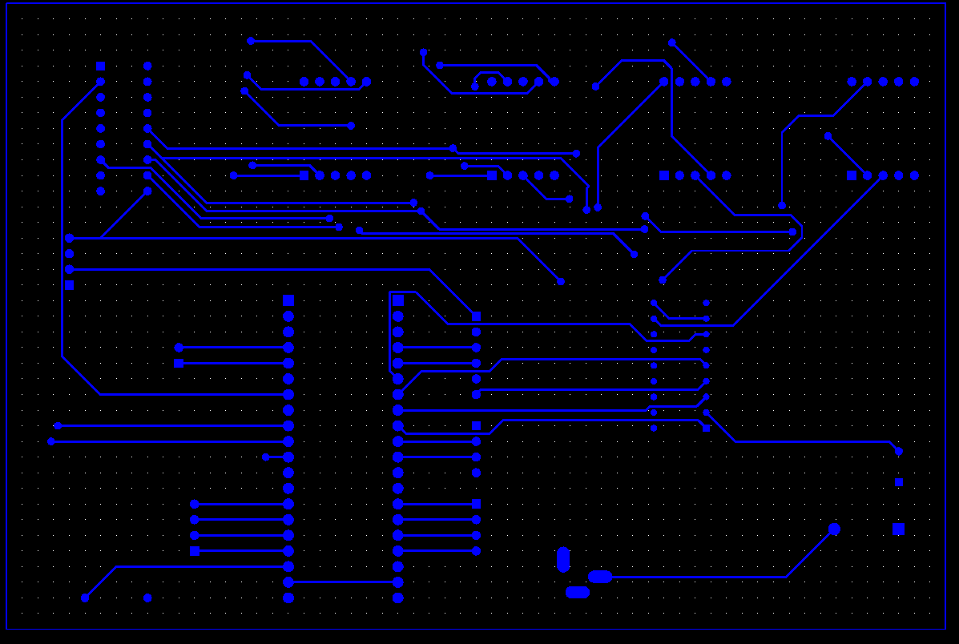
Job( automation)
Transport to
top/bottom
Lines and holes
, and text

Slide 6
BOM Project Digitale Klok
Resistors
Mfr. Name | Mfr. No | Sch. No | Description | Value | Quantity | Price/Unit | Price/total | Delivery date | LINK
YAGEO | RC0805FR-0710KL | R1 | SMD chip resistor 0805, 10 k-Ohms | 10kΩ | 1x | 0.3 | € 0.30 | 02.05.2020 | https://www.reichelt.com/be/nl/smd-chipweerstand-0805-5-10-kohm-0-1-spr-0805-5-10k-p123287.html?PROVID=2788&gclid=EAIaIQobChMI46uZqa_55wIVCeN3Ch0jKgN-EAQYASABEgJB2vD_BwE&&r=1
RND COMPONENTS | RND 1550805S8F430JT5E | R5…R11,R13…R19,R21…R27,R29…R35 | SMD Resistor 0805, 43 Ohm, 125 mW, 1% | 43Ω | 24x | 0.012 | € 0.01 | 02.05.2020 | https://www.reichelt.com/be/nl/smd-weerstand-0805-43-ohm-125-mw-1-rnd-0805-1-43-p212713.html?PROVID=2788&gclid=EAIaIQobChMInLSN_a_55wIVWeh3Ch1RlQwNEAQYASABEgKPgvD_BwE&&r=1
PANASONIC | ERA6AEB681V | R12,R20,R28,R36 | SMD chip resistor 0805, 680 ohm, 0.1% | 680Ω | 4x | 0.211 | € 0.21 | 02.05.2020 | https://www.reichelt.com/be/nl/smd-chipweerstand-0805-680-ohm-0-1-spr-0805-680-p123243.html?r=1
YAGEO | CFR-25JT-52-10K | R1,R2 | Carbon film resistor 1/4W, 5%, 10 kilo-ohms | 10kΩ | 2x | 0.03 | € 0.03 | 02.05.2020 | https://www.reichelt.com/be/nl/koolstoffilmweerstand-1-4w-5-10-k-ohm-1-4w-10k-p1338.html?PROVID=2788&gclid=EAIaIQobChMIsPDCi6z55wIVwuF3Ch2dMQ0EEAQYASABEgIoZPD_BwE&&r=1
YAGEO | MF0207FTE52-1K | R3,R4 | Metal film resistor 1.00 kOhm | 1kΩ | 2x | 0.5 | € 0.50 | 02.05.2020 | https://www.reichelt.com/be/nl/metaalfilmweerstand-1-00-k-ohm-metall-1-00k-p11403.html?r=1
YAGEO | MF0207FTE52-220R | R5…R7 | Metal film resistor 220 Ohm | 220Ω | 3x | 0.5 | € 0.50 | 02.05.2020 | https://www.reichelt.com/be/nl/metaalfilmweerstand-220-ohm-metall-220-p11627.html?PROVID=2788&gclid=EAIaIQobChMIpJyLyLL55wIVj-J3Ch3PLgyCEAQYAiABEgLTLPD_BwE&&r=1
TOTAL |  |  |  |  |  |  | € 1.55
Capacitors
Mfr. Name | Mfr. No | Sch. No | Description | Value | 1 person | Price/Unit | Price/total | Delivery date
PANASONIC | EEUFC1E101S | C1 | Radial electrolytic capacitor, 105°C, low ESR, spacing 2.5 mm | 100µF | 1x | 0.17 | € 0.17 | 02.05.2020 | https://www.reichelt.com/be/nl/elco-radiaal-105-c-laag-esr-rm-2-5mm-rad-fc-100-25-p84618.html?r=1
KEMET | C0805C334K5RACTU | C2 | Multi-layer ceramic capacitor, 330nF, 50V, 125°C | 330nF | 1x | 0.09 | € 0.09 | 02.05.2020 | https://www.reichelt.com/be/nl/multilayer-keramische-condensator-330nf-50v-125-c-kem-x7r0805-330n-p207075.html?r=1
KEMET | C0805C104K5RAC7025 | C3,C6,C7 | Multilayer-keramische condensator, 100nF, 50V, 125°C | 100nF | 3x | 0.05 | € 0.05 | 02.05.2020 | https://www.reichelt.com/be/nl/multilayer-keramische-condensator-100nf-50v-125-c-kem-x7r0805-100n-p207073.html?r=1
AVX | TPSA105K020R3000 | C4,C5 | SMD-Tantal capacitor, 1µF, 20V | 1µF | 2x | 0.14 | € 0.14 | 02.05.2020 | https://www.reichelt.com/be/nl/smd-tantaal-condensator-1-f-20v-tps-3216-1-0-20-p167044.html?r=1
KEMET | Z5U-5 100N | C1_sensor | Multi-layer ceramic capacitor 100N, 20% | 100 nF | 1x | 0.7 | € 0.70 | 02.05.2020 | https://www.reichelt.com/be/nl/meerlaagse-keramische-condensator-100n-20-z5u-5-100n-p22986.html?r=1
TOTAL |  |  |  |  |  |  | € 1.15
Semi-conductors
Mfr. Name | Mfr. No | Sch. No | Description |  | 1 person | Price/Unit | Price/total | Delivery date
ON-SEMICONDUCTOR | MC7805CD2TG | IC1 | Linear voltage regulator 5V, D2PAK |  | 1x | 0.41 | € 0.41 | 02.05.2020 | https://www.reichelt.nl/spanningsregelaar-5-v-d2pak-mc-7805-cd2tg-p188900.html?r=1
TEXAS INSTRUMENTS | ULN2803ADWR | IC2 | Darlington-transistors TRANSISTOR ARRAYS |  | 1x | 1.16 | € 1.16 | 28.04.2020 | https://www.mouser.be/ProductDetail/Texas-Instruments/ULN2803ADWR?qs=sGAEpiMZZMuo%252BmZx5g6tFCyjMgH57qE9
MICREL | MIC2981 | IC3 | Hi-Voltage, Hi-Current Source Driver Array |  | 1x | 2.56 | € 2.56 | 08.05.2020 | https://www.microchip.com/wwwproducts/en/MIC2981#additional-features
ON-SEMICONDUCTOR | BS170 | BS170 | MOSFET N-Channel MOSFET |  | 1x | 0.405 | € 0.41 | 28.04.2020 | https://www.mouser.be/ProductDetail/ON-Semiconductor-Fairchild/BS170?qs=FOlmdCx%252BAA0Q%252B3zvwxJUKQ%3D%3D&gclid=EAIaIQobChMIiIPs1IuJ6QIVFM53Ch0OJwCmEAAYASAAEgLWEPD_BwE
ESPRESSIF | 18423 |  | ESP32-PICO-Kit V4 |  | 2x | 9.95 | € 9.95 | 03.05.2020 | https://www.elektor.nl/esp32-pico-kit-v4
KINGBRIGHT | SA56-11EWA | LD1…LD4 | 7-segment display, red, 14.2 mm, common anode |  | 4x | 0.97 | € 0.97 | 02.05.2020 | https://www.reichelt.com/be/nl/7-segment-weergave-rood-14-2mm-vlgs-anode-sa-56-11-rt-p54112.html?PROVID=2788&gclid=EAIaIQobChMIh5zInZL85wIVicx3Ch3VugjAEAQYByABEgJcd_D_BwE&&r=1
TOTAL |  |  |  |  |  |  | € 15.46
Other parts
Mfr. Name | Mfr. No | Sch. No | Description |  | 1 person | Price/Unit | Price/total | Delivery date
CUI DEVICES | CPI-1762-90-SMT-TR | Buz1 | Piezo Buzzers & Audio Indicators 17 mm, 12 Vdc, 90 dB, Surface Mount, Driving Circuit, Piezo Audio Indicator Buzzer |  | 1x | 2.49 | € 2.49 | nog bestellen | https://www.mouser.be/ProductDetail/CUI-Devices/CPI-1762-90-SMT-TR?qs=xZ%2FP%252Ba9zWqbry7ehbJfJGw==
/ | 1063952 | S1 | Wipschakelaar |  | 1x | 1.29 | € 1.29 | nog bestellen | https://www.allekabels.be/schakelaar/7303/1063952/wipschakelaar.html?gclid=EAIaIQobChMIvcrPmvyS6QIVVON3Ch0MtwwREAYYAiABEgK64vD_BwE
WURTH ELEKTRONIK | 694108402002 | K6 | DC Power Connectors WR-DC PwrJk CtrPnTHT Vertical |  | 1x | 1.04 € | € 1.04 | 28.04.2020 | https://www.mouser.be/ProductDetail/Wurth-Elektronik/694108402002?qs=%2Fha2pyFadug%2FFaPgD3oNbyDjtXPRf%2FlQ%2F8dvAryCXRsND5Fks8bEhg%3D%3D
JOY-IT | SEN-DHT22 | / | Temperature & humidity sensor DHT22 |  | 1x | 6.09 € | € 6.09 | nog bestellen | https://www.reichelt.com/be/nl/ontwikkelaarsboards-temperatuur-en-vochtigheidssensor-dht22-debo-dht-22-brd-p266104.html?PROVID=2788&gclid=EAIaIQobChMI_LWy5qup6QIVUeJ3Ch2iDQEsEAQYASABEgIu8_D_BwE&&r=1
RND CONNECT | RND 205-00650 | K1_sensor,K2_sensor | RND Pinheader female, 10-pin, RM 2,54 mm |  | 8x | 0.12 | € 0.12 | 02.05.2020 | https://www.reichelt.com/be/nl/rnd-bus-header-4-polig-rm-2-54-mm-rnd-205-00644-p208870.html?r=1
RND CONNECT | RND 205-00646 | K2 | RND Pinheader female, 6-pin, RM 2,54 mm |  | 1x | 0.8 | € 0.80 | 02.05.2020 | ||
RND CONNECT | RND 205-00644 | K3..K5,K11 | RND Pinheader female, 4-pin, RM 2,54 mm |  | 4x | 0.06 | € 0.06 | 02.05.2020 | ||
RND CONNECT | RND 205-00643 | K3_sensor | RND Pinheader female, 3-pin, RM 2,54 mm |  | 1x | 0.06 | € 0.06 | 02.05.2020 | ||
RND CONNECT | RND 205-00642 | K1 | RND Pinheader female, 2-pin, RM 2,54 mm |  | 1x | 0.4 | € 0.40 | 02.05.2020 | ||
/ | LED 3MM RT | LED1..LED3 | LED, 3 mm, low-cost, red |  | 3x | 0.7 | € 0.70 | 02.05.2020 | https://www.reichelt.com/be/nl/led-3-mm-gekleurd-4-5-mcd-rood-led-3mm-rt-p10228.html?r=1
TOTAL |  |  |  |  |  |  | € 13.05
Shipping costs
Webshop |  |  |  |  |  |  | Price
Reichelt |  |  |  |  |  |  | € 9.95
Mouser |  |  |  |  |  |  | € 20.00
Elektor |  |  |  |  |  |  | € 7.95
Microship |  |  |  |  |  |  | € 5.78
TOTAL |  |  |  |  |  |  | € 43.68
TOTAL PRICE |  |  |  |  |  |  | € 74.89
74.90 euro
Reichelt
Mouser
Elektor
Microship
€ 43.68 shipping

Slide 7
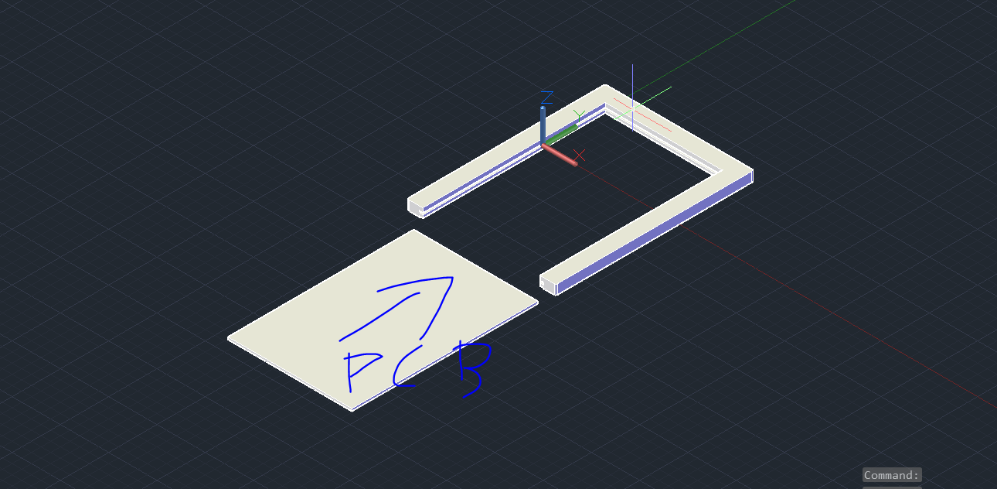
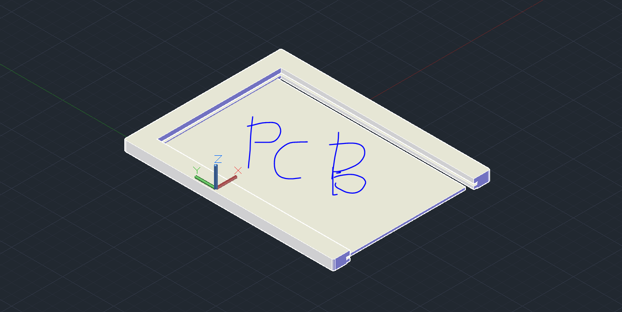
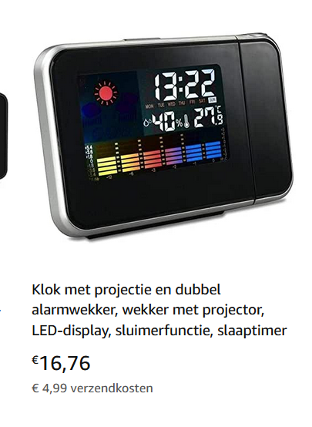
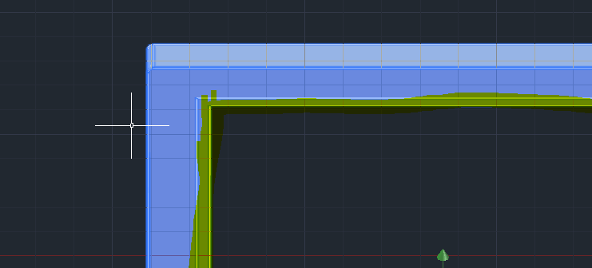
Case
Click in case
Open components
Simple > profecional
Project/price
Bottom Plate?

Slide 8
References

